Slide 1
My presentation
Yongjian Feng

Slide 2
Overview
Education background
Working experiences
Technical overview of a project

Slide 3

Education Background
Ph. D degree on high energy physics from McGill University.
Carl Reinhardt McGill Major Fellowship
6 publications
5 on Physical Rev D
1 on Journal of Mathematical Physics (using Mathematica)

Slide 4

Education background
Master degree of Computer Science from Boston University
GPA 3.89
Love design patterns
Was hired as a part time faculty after graduation

Slide 5

Education background
Bachelor degree on physics from Peking University
Best university in China
Solid math training
GPA 3.90

Slide 6
Education background
Summary
Well-educated in computer science and OOD
Solid math background, still crazy about math
Part time faculty of BU, teaching online course of Calculus and Statistics
Outstanding problem solver
Logic helps
Math helps!

Slide 7
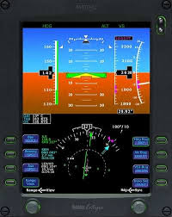
Working experience: Avidyne
Software Engineer in Avidyne
Develop avionics SW for General Aviation (GA) airplanes
Parser of GPS/Altitude data from sensors
Graphic display of GPS data using OpenGL
C++ program running on embedded RTOS system
FAA-DO178B Level B certification

Slide 8

Working experience: AvidyNE
Piper is one of the customer

Slide 9
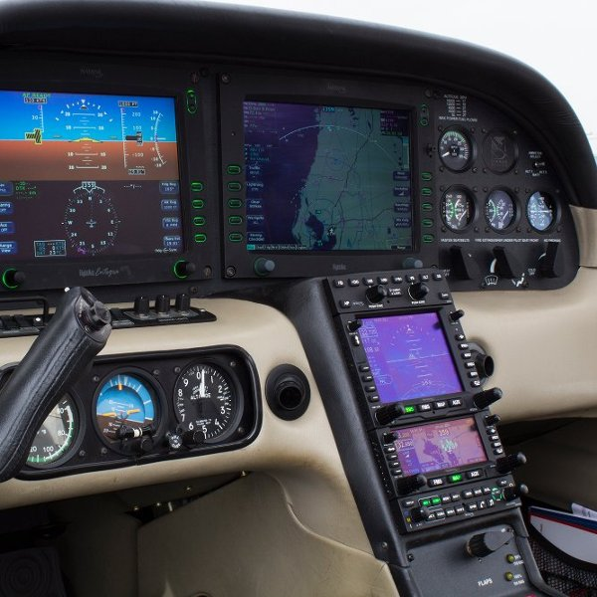
Working experience: AvidyNE
Primary Flight Display (PFD, left)
Navigation Display (ND, right)

Slide 10
Working experience: AvidyNE
FAA-DO178B regulations
Regulations about processes and documents
Planning: HLR
Development
LLR
SDD (Software Design Document)
Source code
Deliverable

Slide 11
Working experience: AvidyNE
FAA-DO178B
Regulations about processes and documents (continue)
Verification
Software verification cases and procedures (SVCP)
Software verification results (SVR)
Linkage/traceability among documents
Code coverage analysis

Slide 12
Working experience: AvidyNE
FAA-DO178B level B certification
Level B for critical systems of GA (GA doesn’t need Level A)
100% condition coverage
Documents need independent review, including traceability review

Slide 13
Working experience: AvidyNE
FAA-DO178B Important takeaways
Document almost everything (for record/audit)
Traceability
Independent review, including code, documents, traceability
Independent QA

Slide 14
Working experience: EMC
10 years C++ development experience in information security
Cryptography using OpenSSL and RSA MES lib
FIPS compliance
iOS development
Acrobat SDK for PDF
Microsoft Structure Storage and OpenXML
Integration in multithreaded env

Slide 15
Working experience: EMC
Acrobat plugin and Acrobat SDK
Adobe Acrobat (and Reader) supports plugin.
Handler (IRM plugin is a security handler)
Can hook to acrobat functions/operations
Example hook to pageOpen call
Acrobat SDK and PDF spec

Slide 16
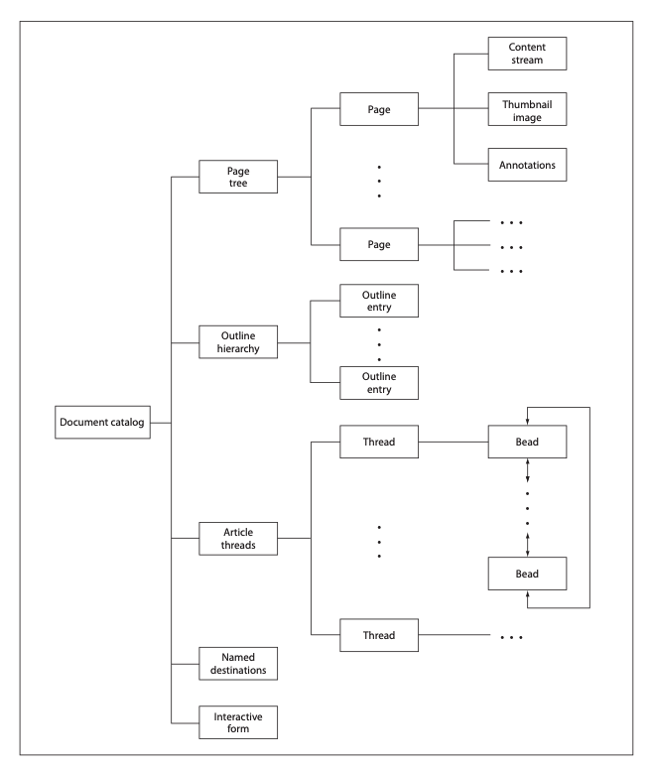
Working experience: EMC
Acrobat SDK for PDF
PDF is a hierarchy of objects (PDF spec)
Dictionary
Integer
Boolean
…
Acrobat SDK provides function to access/manipulate these objects

Slide 17
Working experience: EMC
Pseudocode for encrypting a PDF document
Generate a key and a unique doc_id
Loop through all pages of a PDF
Read content from cur page
Encrypt
Write encrypted content to page
Update catalog dict with doc_id and host information
Upload key and doc_id to IRM server

Slide 18
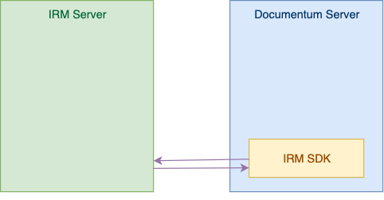
Working experience: EMC
Integration in multi-threaded env
EMC Documentum is a repo
IRM is used to extend protection for checked out documents
Batch checkout is running with multiple threads
IRM SDK needs to support multithread env

Slide 19
Working experience: EMC
Integration in multi-threaded env
Expert in multi-threaded support
Top performer of EMC IIG
Fixed a multi-threaded issue for a high profile customer
EMC silver level award
Debugged a multi-threaded issue for RSA MES lib

Slide 20
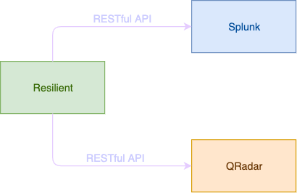
Working Experience: IBM
Machine learning using python packages
Integration with other SIEM systems via RESTful API
IBM QRadar
Splunk

Slide 21
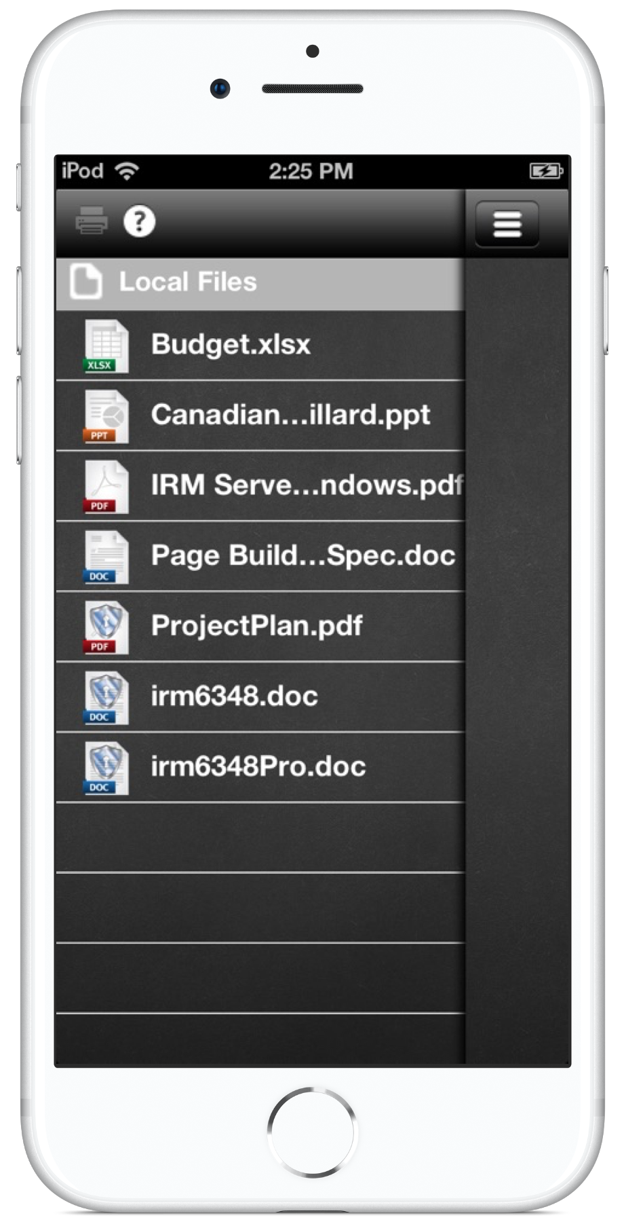
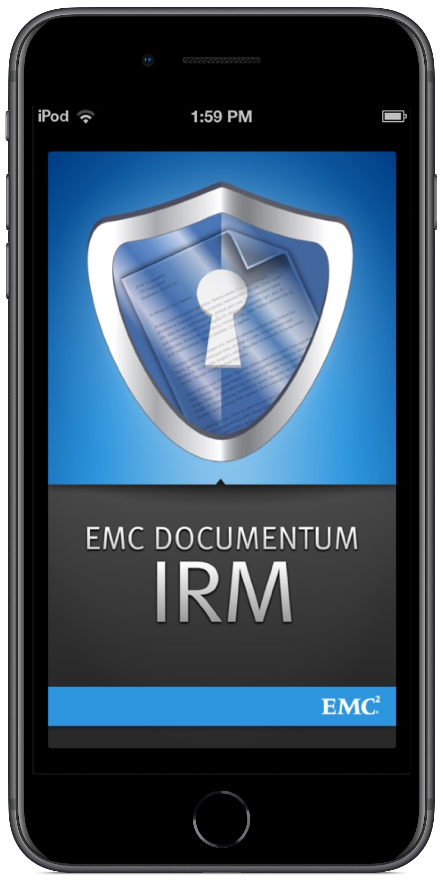
Technical overview
iOS viewer for IRM protected documents
Team lead, work >80%
Structured storage lib in C++ for iOS
iOS PDF framework
Port existing libs to iOS
GUI using Cocoa framework

Slide 22
Technical overview
GUI using Cocoa framework (menu, button, toolbar, popup)
GUI (menu, button, toolbar, popup)
Content encrypt/decrypt
Server authentication
Permission management
iOS structured storage libs
Windows structured storage libs
Acrobat SDK for PDF
iOS PDF framework
iOS viewer project overview/scope

Slide 23
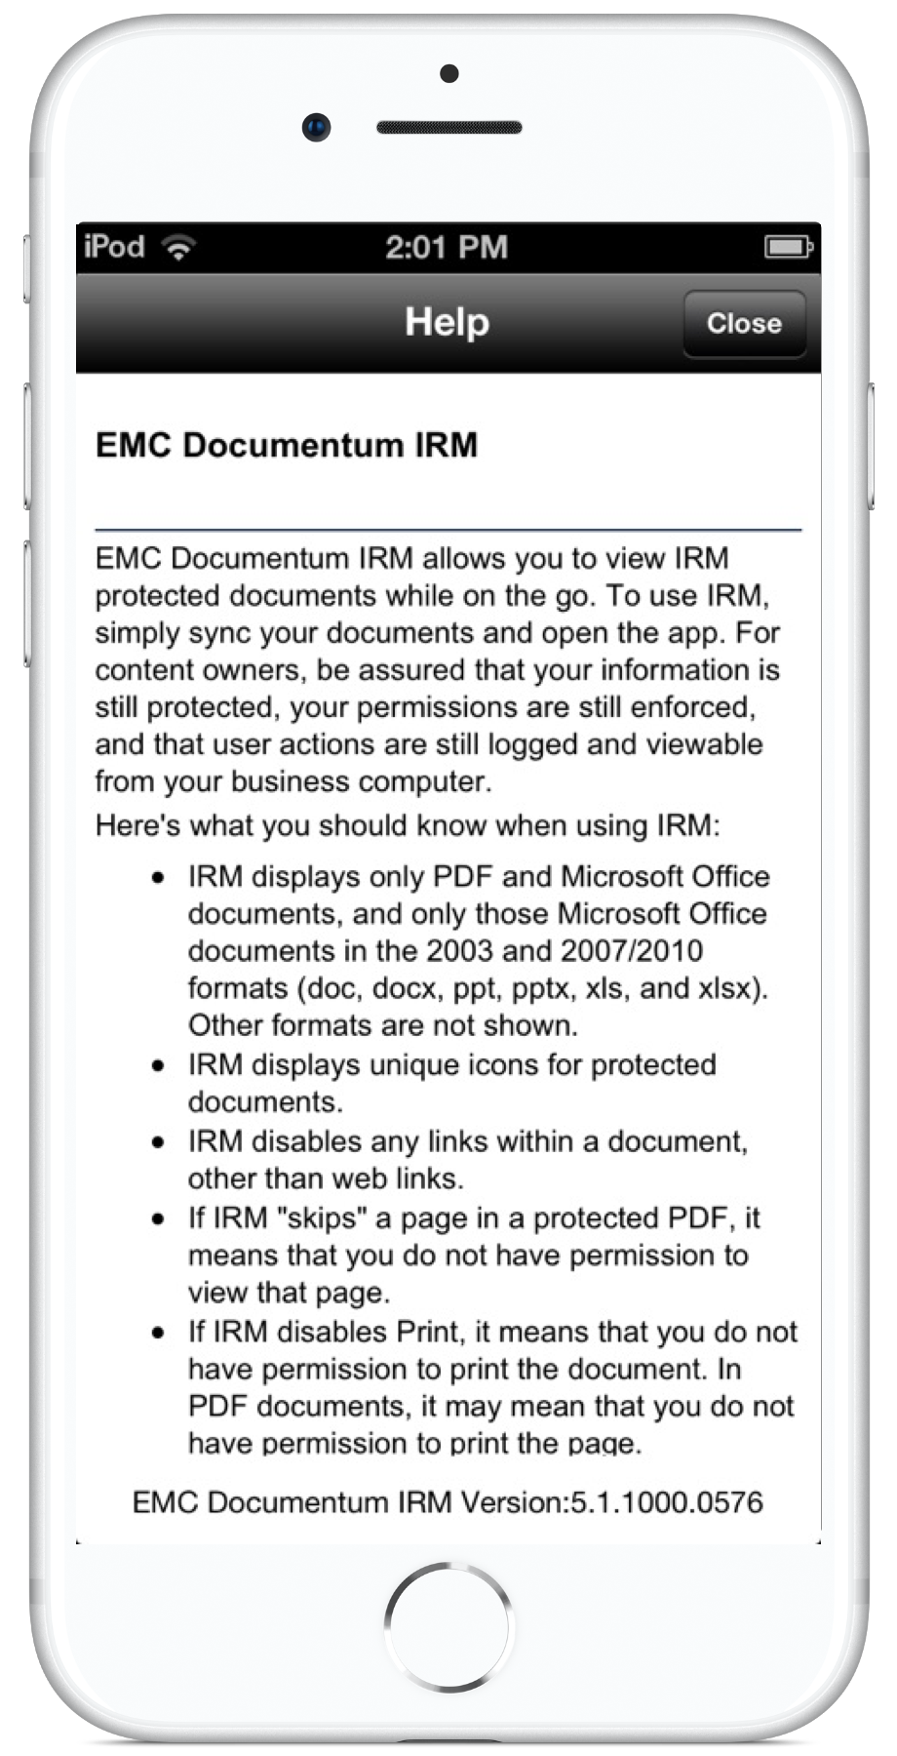
Technical overview
Structured Storage library
OLE (Object Linking and Embedding)
Good for
Incremental access
Multiple user access
Transaction processing
Low memory saves

Slide 24
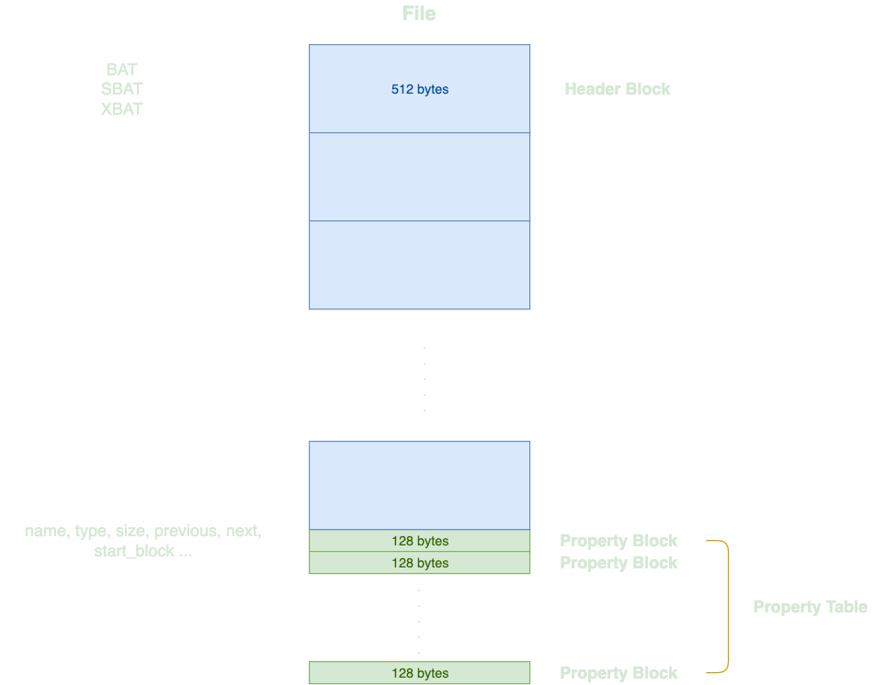
Technical overview
Structured Storage: overview
Broken down as blocks
BigBlock 512; PropBlock 128
Each object is represented by a property block
A property can be either a storage or stream
Like a file system
Storage ~ Folder; Stream ~ File
Each property block is linked to one or more BigBlock

Slide 25
Technical overview
Structure Storage: How to use structure storage
Just like access a file system
Every object is a property
A property can be either a Storage(folder) or Stream (file)
Create, modify, delete objects
Content of an object is stored in data block(s)
Data blocks are linked by BAT (Block Allocation Table)

Slide 26
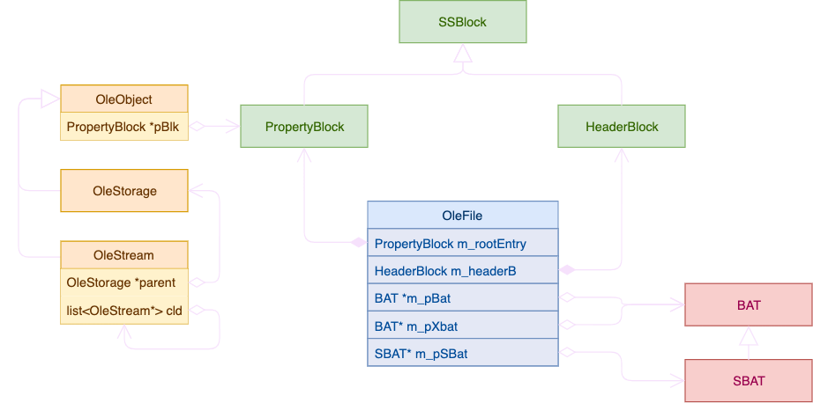
Technical overview
Structure Storage: UML

Slide 27
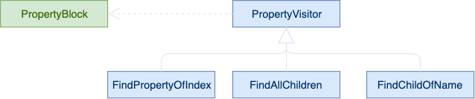
Technical overview
Design pattern
Use Visitor Design pattern to travers the property structure

Slide 28
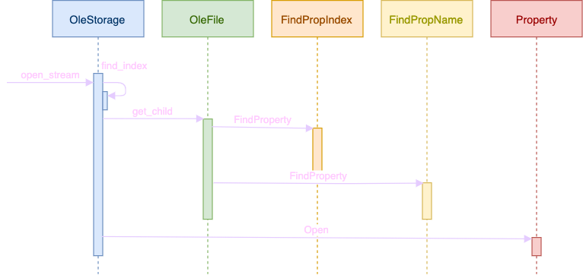
Technical overview
One method OleStorage: Open a child stream by name to read

Slide 29
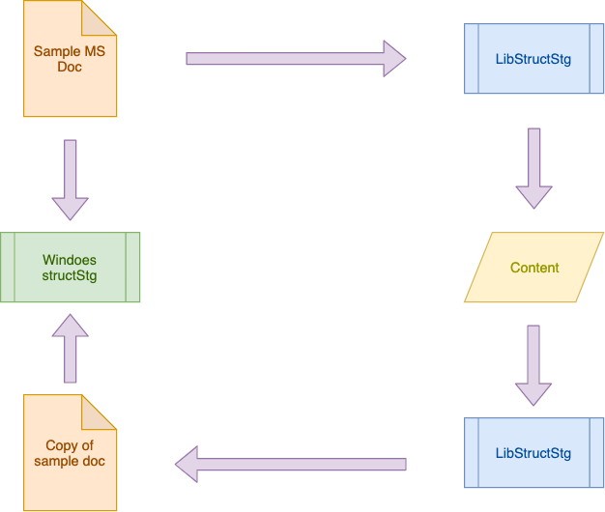
Technical overview
Test: Run through a large collection of MS documents

Slide 30
Technical overview
Design pattern
IRM Software
Windows library
Adaptor
StructStg lib
Use Adaptor design pattern to convert interface

Slide 31
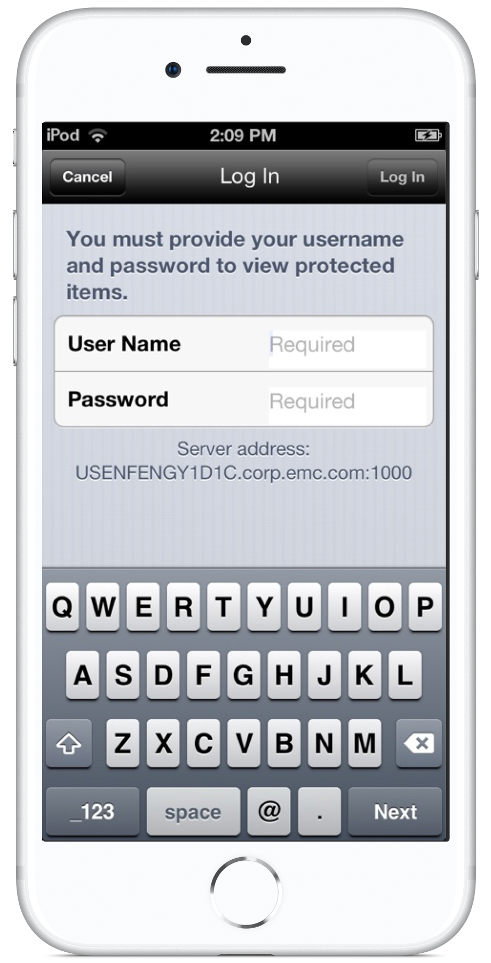
Technical overview
GUI with Cocoa framework

Slide 32
Technical overview
GUI using Cocoa framework of Objective-C
Model-View-Control
Adapter and protocols
Command and button
Composite and view hierarchy

Slide 33
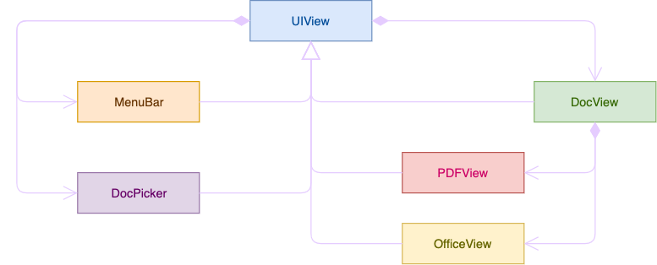
Technical overview
Cocoa Framework

Slide 34
Technical overview
Difficulty and solution
Performance for large document
Multi-thread decryption. Decrypt the next page using background thread
Cached decrypted pages

Slide 35
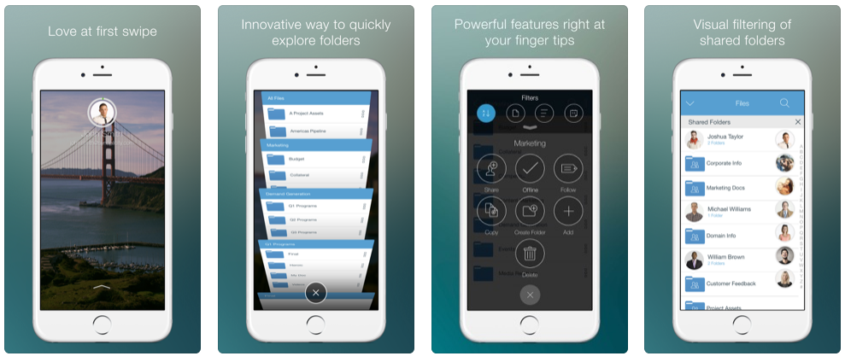
Technical overview
Lessons learned
Graphic design is very very important. Attention to small details.

Slide 36
Technical overview
Lessons learned
Easy to use is very important
Integration with Documentum to download/upload document
One patent for better user experience.

Slide 37
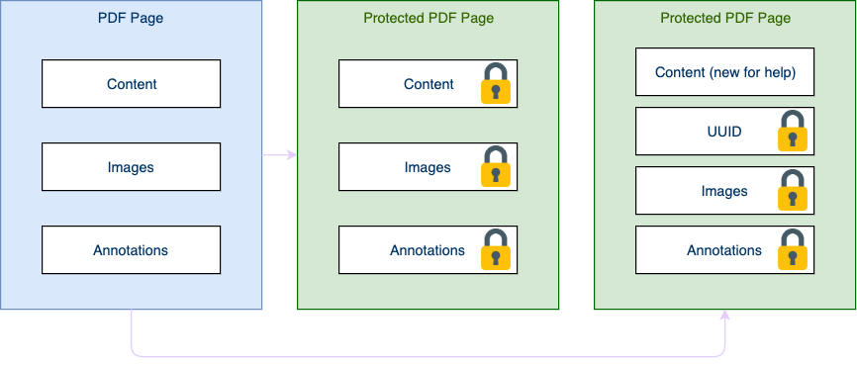
Technical overview (Optional)
Patten

Slide 38
Q&A
Thanks!

